Slide 1
TRANSPLANTATION AND ORGAN DONATION USING BLOCKCHAIN
Team Details
Anjana (20EG105504)
Rajasri (20EG105554)
Nithin(20EG105553)
Project Supervisor
Mrs.T Veda Reddy
Assistant Professor

Slide 2
Introduction
We propose an Ethereum blockchain-based solution that ensures organ donation and transplantation management in a manner that is decentralized, secure, reliable, traceable, auditable, and trustworthy.
In this project we develop smart contracts that register actors and ensure
data provenance through producing events for all the necessary actions that occur during the organ donation and transplantation stages.
We compare our solution with the existing solutions to show its originality.
Our proposed solution is general and may be easily adjusted to meet the needs of a variety of related applications.

Slide 3
Problem Statement
The current organ donation and transplantation system faces critical challenges, including inefficient recordkeeping ,and a lack of transparency.
Traditional organ donation processes rely on centralized databases and paper work ,errors.
The existing system’s centralized nature poses risks such as data manipulation, unauthorized access.
To overcome these issues this project aims to replace these outdated methods with a decentralized and secure blockchain system.

Slide 4
Proposed Method
The proposed system works based on the existing system’s one of the major problem. In this system, the organ donor’s details are stored even if the organ donor dies.​
If any of the person dies, their tissues such as bone, skin ,heart valves, veins, tendons, ligaments and corneas can be donated within the first 24 hours of death.​
And even the organs that can be donated after death are heart, liver, kidneys, lungs, pancreas, and small intestines. These details can also be included into the database list.
The proposed system works based on the existing system’s one of the major problem. In this system, the organ donor’s details are stored even if the organ donor dies.
If any of the person dies, their tissues such as bone, skin ,heart valves, veins, tendons, ligaments and corneas can be donated within the first 24 hours of death.
And even the organs that can be donated after death are heart, liver, kidneys, lungs, pancreas, and small intestines. These details can also be included into the database list.

Slide 5
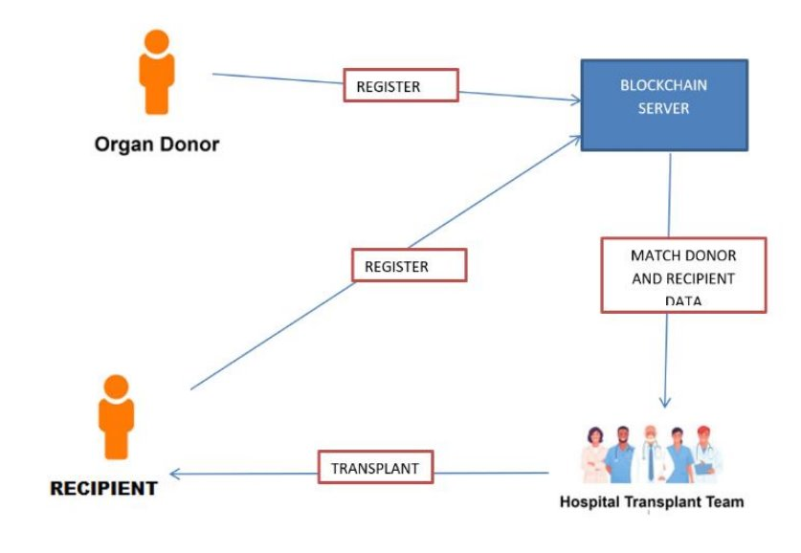
Proposed Method

Slide 6
Experiment Environment
HARDWARE SPECIFICATION ​
Processor : Any Processor above 500 MHz​
Ram : 128Mb.​
Hard Disk : 10 GB.​
Input device : Standard Keyboard and Mouse.​
Output device : VGA and High Resolution Monitor.​
​
SOFTWARE SPECIFICATION​
​
Operating System : Windows Family.​
Programming Language : Java, HTML​
Database : SQL​
IDE :VSCODE​, Ganache

Slide 7
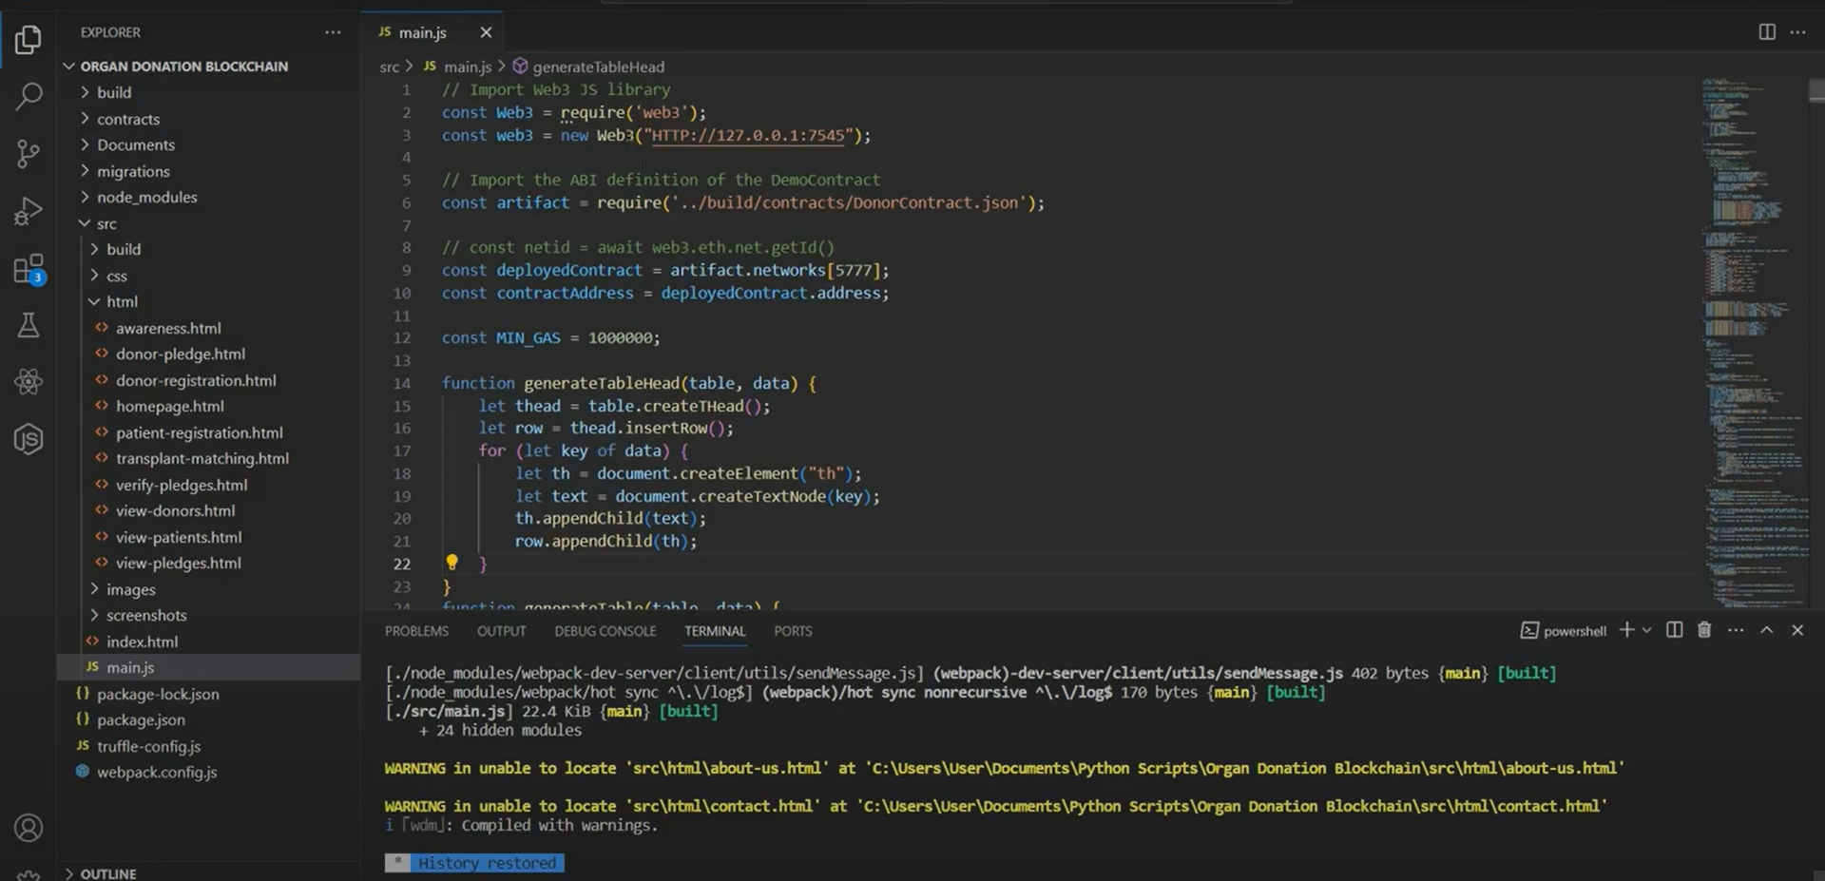
Experiment Screen shots

Slide 8
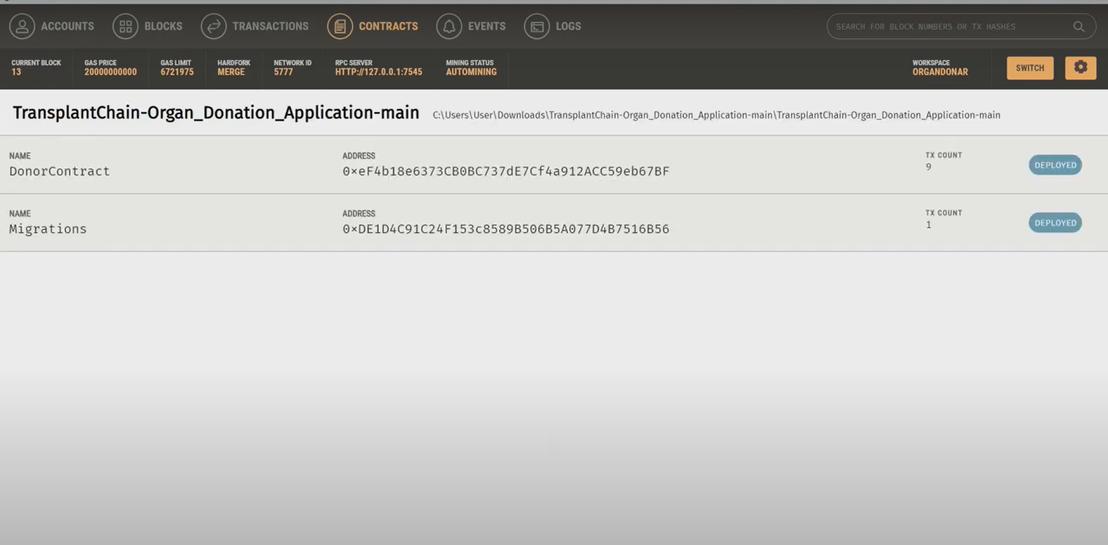
Experiment Results

Slide 9
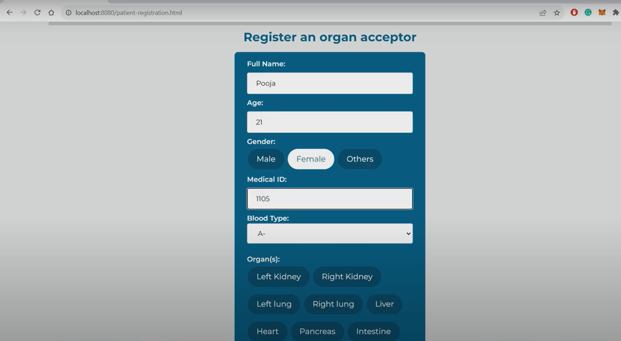
Experiment Results

Slide 10
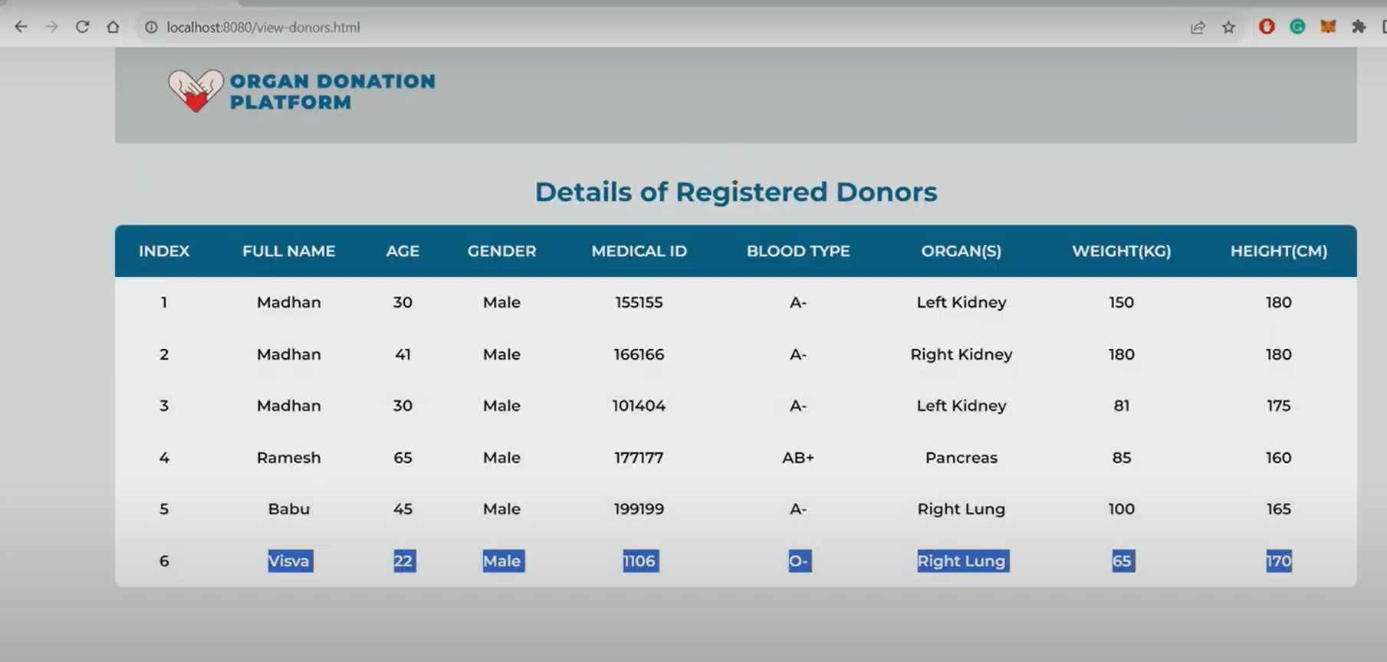
Experiment Results

Slide 11
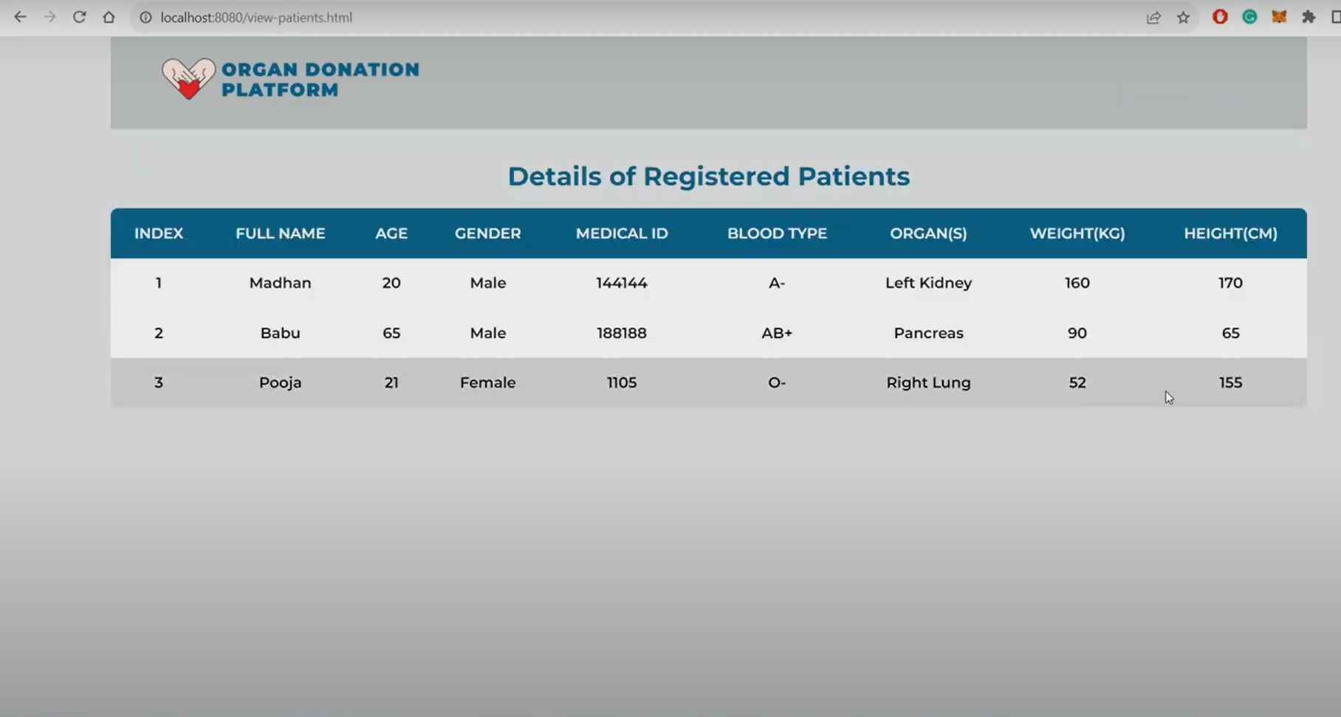
Finding

Slide 12
Justification
In non-blockchain-based processes, various approaches and tools are utilized to come up with solutions that enhance organ donation, transplantation management, and the matching process.
Earlier, they developed a multi-agent software platform to represent the information workflow model among donor hospitals, regulators, and recipient hospitals.
This platform optimizes the pre-transplantation tasks, which can improve the process efficiency.
In addition, it allows storing potential donor information and improves direct communication among all participants in the organ transplantation process.
An information workflow was simulated using the developed platform, and it was estimated that the saved time might be between three to five hours.

Slide 13
Thank You

